Slide 1

STOCK PRICE PREDICTIONS

Slide 2
Hello!
Done By: Zeinelabdin Salih
Instructor: Vijay Kumar
March 27, 2021

Slide 3
Page | Content | Slides
1 | Title / Name / Date | 1 - 2
2 | Outline | 3
3 | Introduction / Executive Summary | 4 - 5
4 | Project Obejtives | 6
5 | Hypotheses Generation | 7 - 8
6 | Methodology | 9 – 10
7 | Descriptive Analytics | 11 - 16
8 | Assumptions | 17 - 18
9 | Predication Models | 19 - 23
11 | Conclusions | 24

Slide 4
Introducation
Dataset Brief:
This dataset is mainly created for analyzing the historical stock price of TSLA. Starting from 2010 until February 2021.
It contains 7 Variables and 2679 datapoints.
The features of analysis are Date, High, Low, Open, Close, Volume and Adj Close
It can be used to make cool charts of the stock price for learning data analysis for finance.
Our Target variable is “Close” Price
Data source is Kaggle Website

Slide 5
Executive Summary
I checked missing values and possibility of outliers In exploration analysis
Since I am dealing with Time Series data, there are some assumption you have taking caring of it
I used the statistical methods and some graph to explain those assumptions
I used Arima (Auto Regressive Moving Average), Decision Tree and Linear Regression Models to predict the forecast for Tesla stock close price

Slide 6
Project Objectives
Analysis and find the relationship between variables
Build models to predict Tesla Stock Close Price
Observe which model is best for predication
Compare forecast Price with exiting Stock price on Tesla website

Slide 7
Hypothesis Generation
Stock Price Hypothesis Attributes:
Data & Time: which is the much important feature for stocks
Volume of Stocks: Explaining the demand of stocks on daily bases
Open Price: Considered as one of major factors, especially at beginning of the week
High & Low Price: The highest and lowest price stated during a day
Close Price: The super significance attribute, which is used for finding historical insights in order to predict the future forecasting
Adjusted Close Price: Important because it shows the stock's value after dividends are posted
Other Factors : The stock market and price is very sensitive to many aspects for Exp. Profitability of company, Inflation, Investors Movement, Natural Disasters and Pandemics.

Slide 8
Hypothesis Generation
Possible Outcomes
Do the close prices in coming two months it will raise up again?
Will stock volume decrease and drop down the close price as well ?

Slide 9
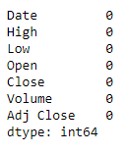
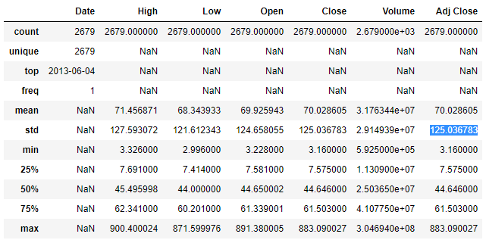
Methodology
The dataset available as structured data in CSV format
I changed the “Date” variable type to date
There no missing values detected
The boxplots graphs showing there some outliers, but In my opinion, I don`t believe that we must treat outliers since we need to check the data stationary
Project done in Jupytor Notebook –
Python 3.8

Slide 10
Methodology
Statistical Methods / Techniques Used:
Installed new environut libraires
Univariate, Multivariate Analysis
User define, Lambda functions
Assumptions Checking: Autocorrelation, Stationary
Predictive Analysis: Arima, Linear Regression and Decision Tree Models

Slide 11
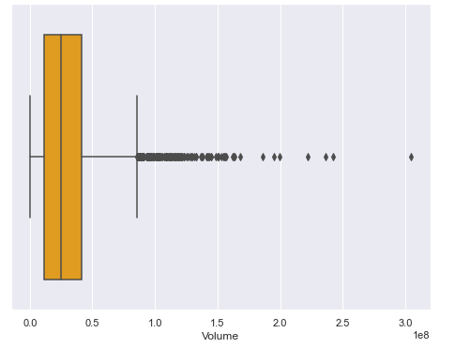
Univariate Analysis
Showing Outliers in Volume varible
Descriptive Analysis
Place your screenshot here

Slide 12
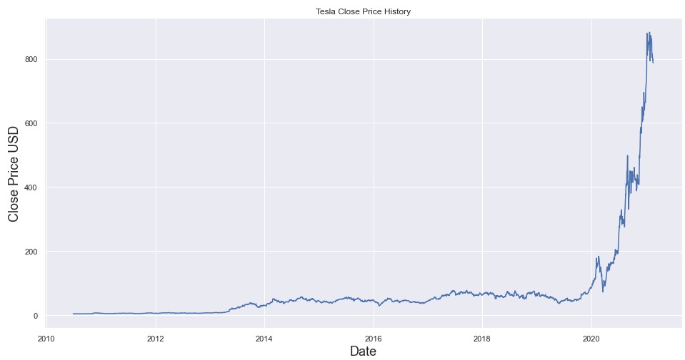
Univariate Analysis
Showing the targe varible Close Price using the linear graph
Descriptive Analysis
Place your screenshot here

Slide 13
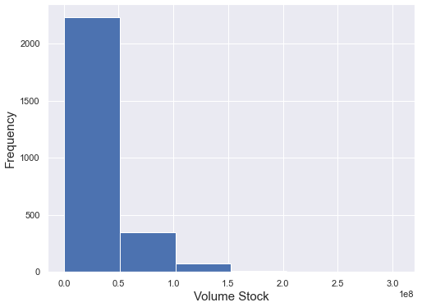
Univariate Analysis
Volume Frequency
Descriptive Analysis
Place your screenshot here

Slide 14
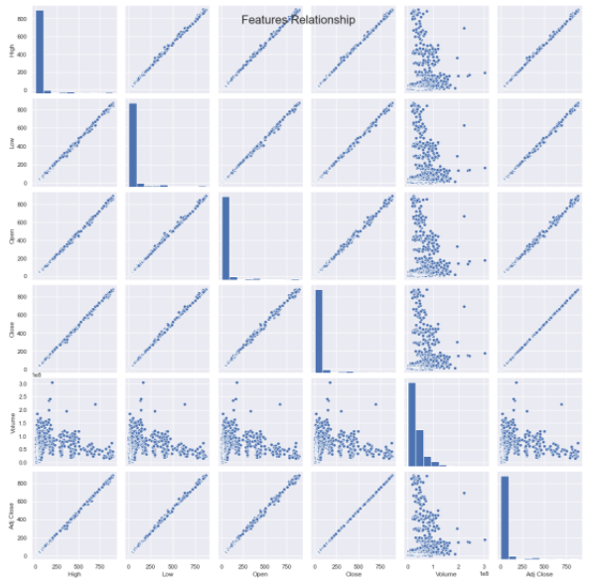
Multivariate Analysis
Varibales Relationships
Descriptive Analysis

Slide 15
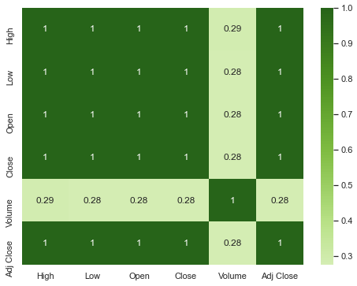
Multivariate Analysis
Show and explain your web, app or software projects using these gadget templates.
Descriptive Analysis
Place your screenshot here

Slide 16
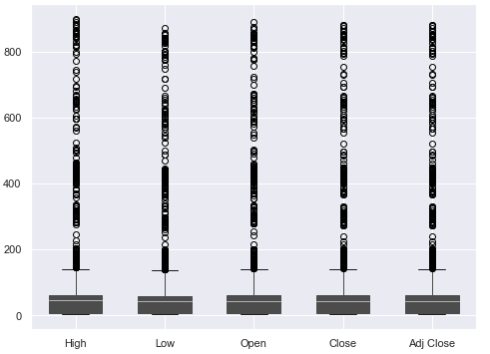
Multivariate Analysis
Visualizing outliers in Stock Price Varibles
Descriptive Analysis
Place your screenshot here

Slide 17
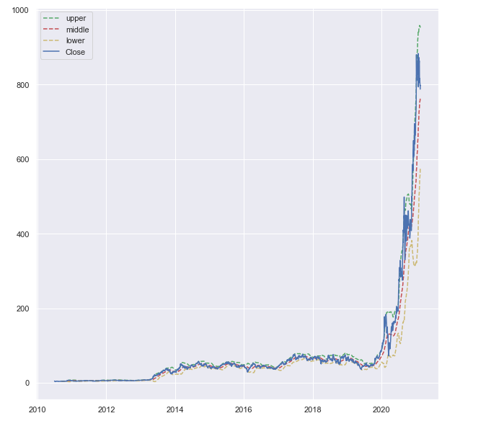
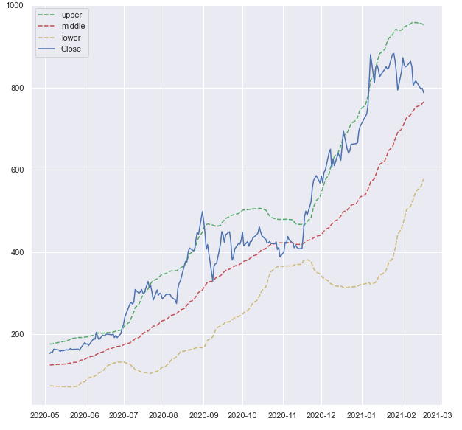

Stationary
We trying to know the close price is stationary or not.
Assumptions

Slide 18
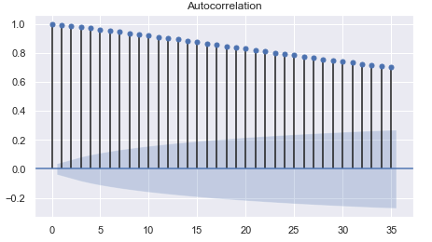
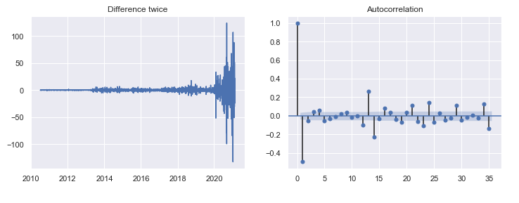
Autocorrelation
Represents the degree of similarity between a given close price
Assumptions

Slide 19
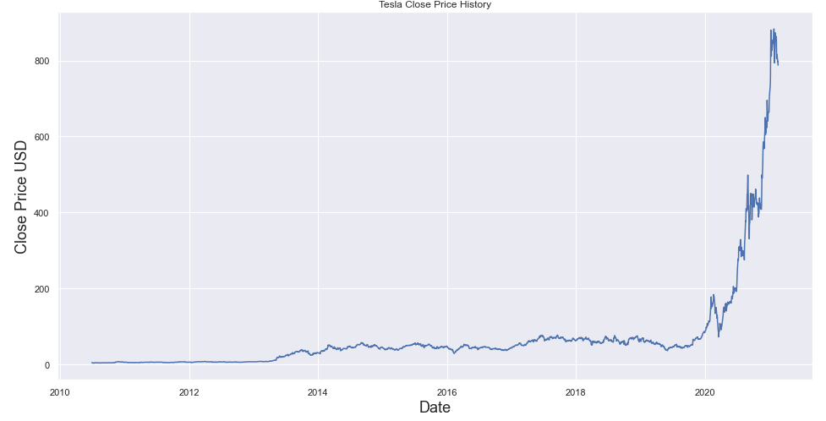
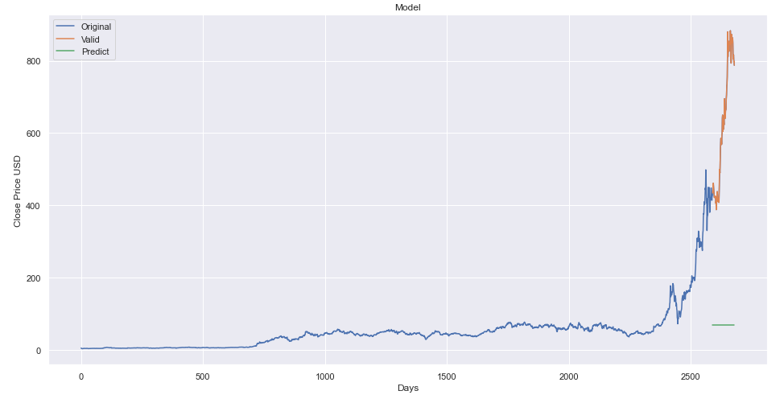
Decision Tree Model
Forecasting the close price and testing
Close Price Predication Models

Slide 20
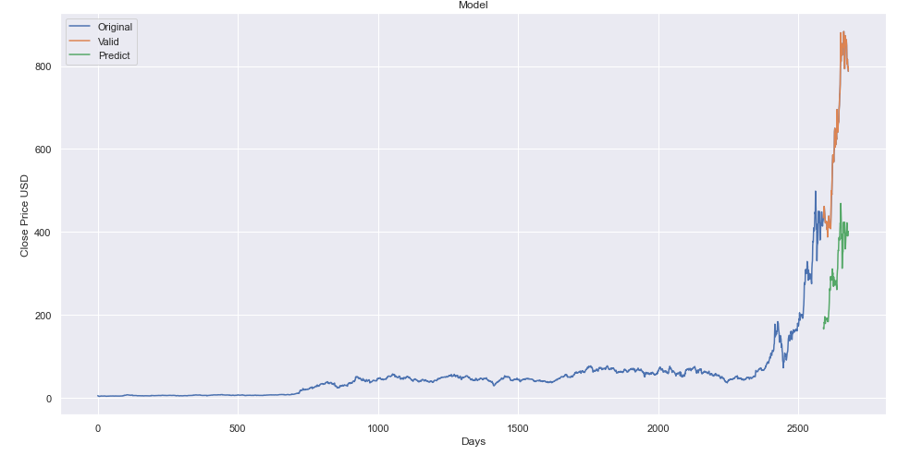
Linear Regression Model
Forecast Prediction for close price and validate the testing data
Close Price Predication Models

Slide 21
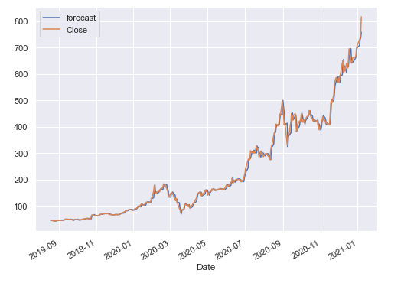
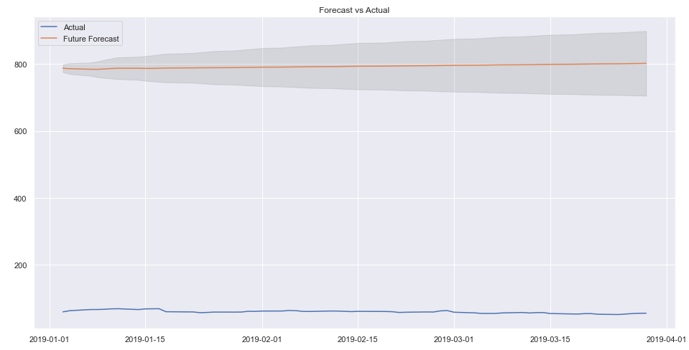
Arima Model – 1st Approach
The graph shows predicted for validation model
Close Price Predication Models

Slide 22
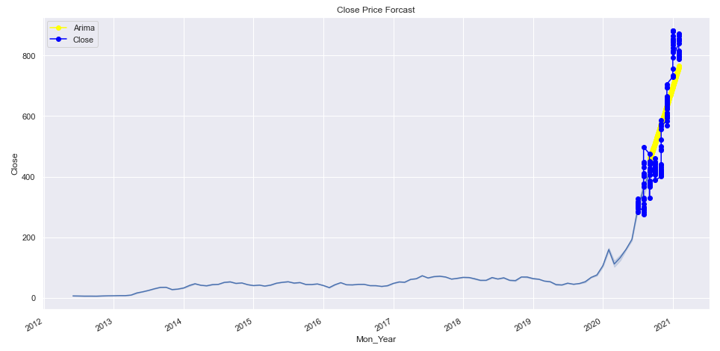
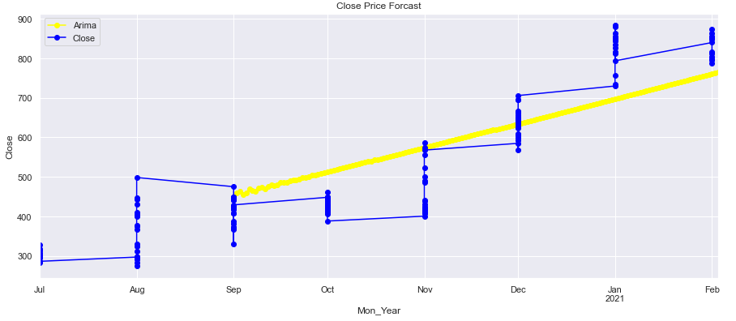
Arima Model - 2nd Approach
The graph shows predicted for validation model
Close Price Predication Models

Slide 23
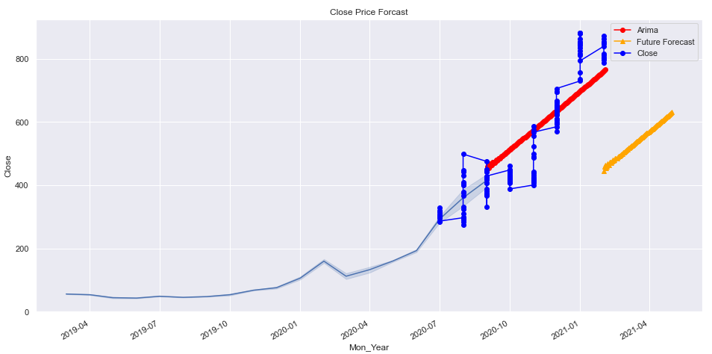
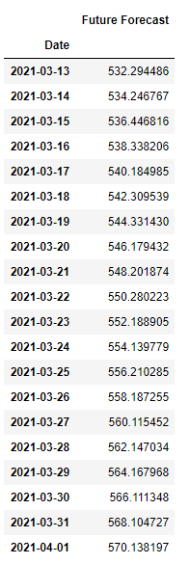
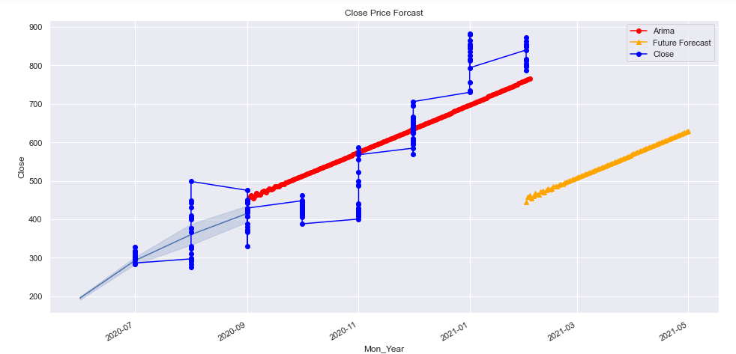
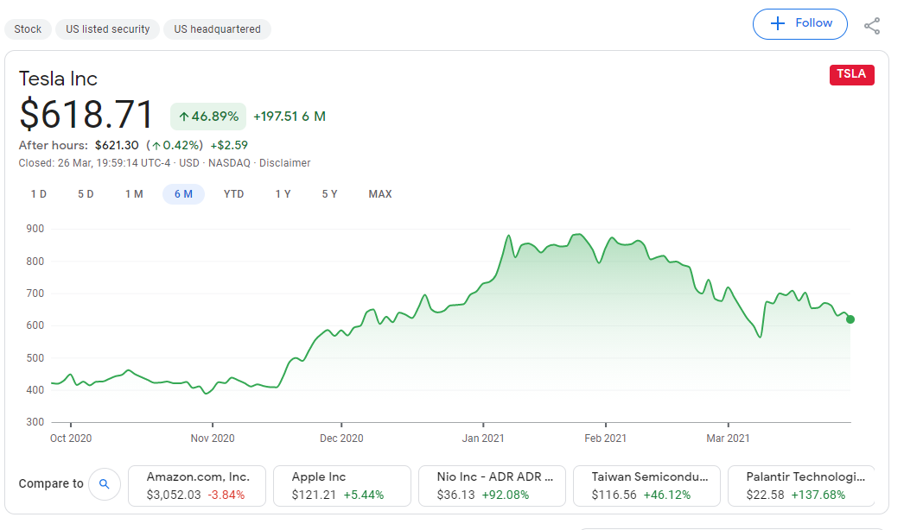
Arima Model - 2nd Approach
Predicted forecast close price for rest of Feb, Mar, 2021
Close Price Predication Models

Slide 24
Conclusions/Findings
The Close Price are Autocorrelated and Non-Stationary
All the variables are highly correlated to target variable
The best model to predict the foresting for Close price is Arima Model
Model observed that the price is dropped down which is true predicted (as I showed in slide 22), still it is not achieved the but it very close.

Slide 25
Thanks!
Any questions?

